Slide 1
Pacemaker
Team 7

Slide 2
Project Proposal Checkbox (DUE 9/27 23:59)
TODO | 담당자 | 완료
Target users and the problem they are facing | 재헌 | O
Existing solutions and their limitations | 재헌 | △
The key solution idea to tackle the problem |  | X
Usage scenarios |  | X
The proposed system overview and specific functions | 재헌/ | △
Expected (technical) challenges and solution ideas !! NOVELTY !! |  | X
Evaluation strategy |  | X
Overall project plan (Gantt Chart ?) |  | O
Final deliverable and success criteria |  | X

Slide 3
Introduction
Main problem:
Many users find it difficult to maintain an optimal pace for the duration of a run
Many factors including weather, current health conditions, terrain, etc. contribute to this difficulty
Existing running apps (Nike, Samsung Health, etc.) measure speed after a workout has ended
This leads to poor feedback during the actual exercise.
Many people do not know how long they should exercise for, with many losing motivation after a few weeks
Solution:
Create a pace-keeping application that monitors a user’s running speed and proposes an optimal pace based on micro/macro factors
Macro factors: target weight, target distance, previous time records, etc.
Micro factors: current terrain conditions (asphalt, incline, etc.), heart rate, etc.
Implement a game system to motivate users to reach their goals
Target audience:
Health-aware users who wish to augment their daily exercises with AI assisted jogging/walking routines
Professional runners who wish to closely monitor their running speed and improve their record times
Anyone who wants to lose weight through consistent exercise

Slide 4
Existing Applications
Runkeeper Elite: paid app that keeps track of runner’s speed
Only updates user on running speed every kilometer (not real-time)

Slide 5
Motivation

Slide 6
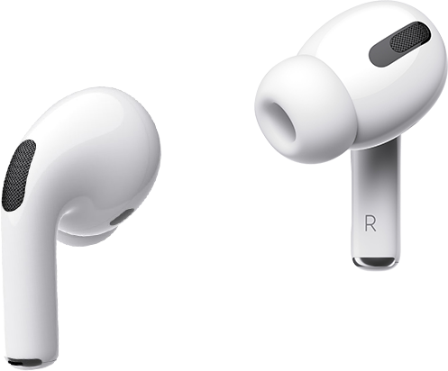
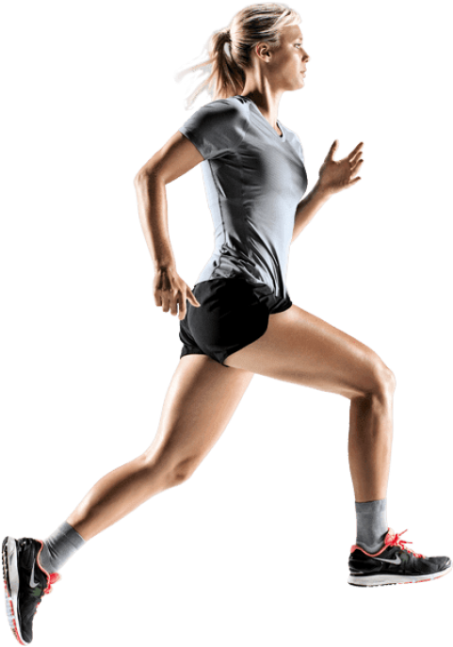
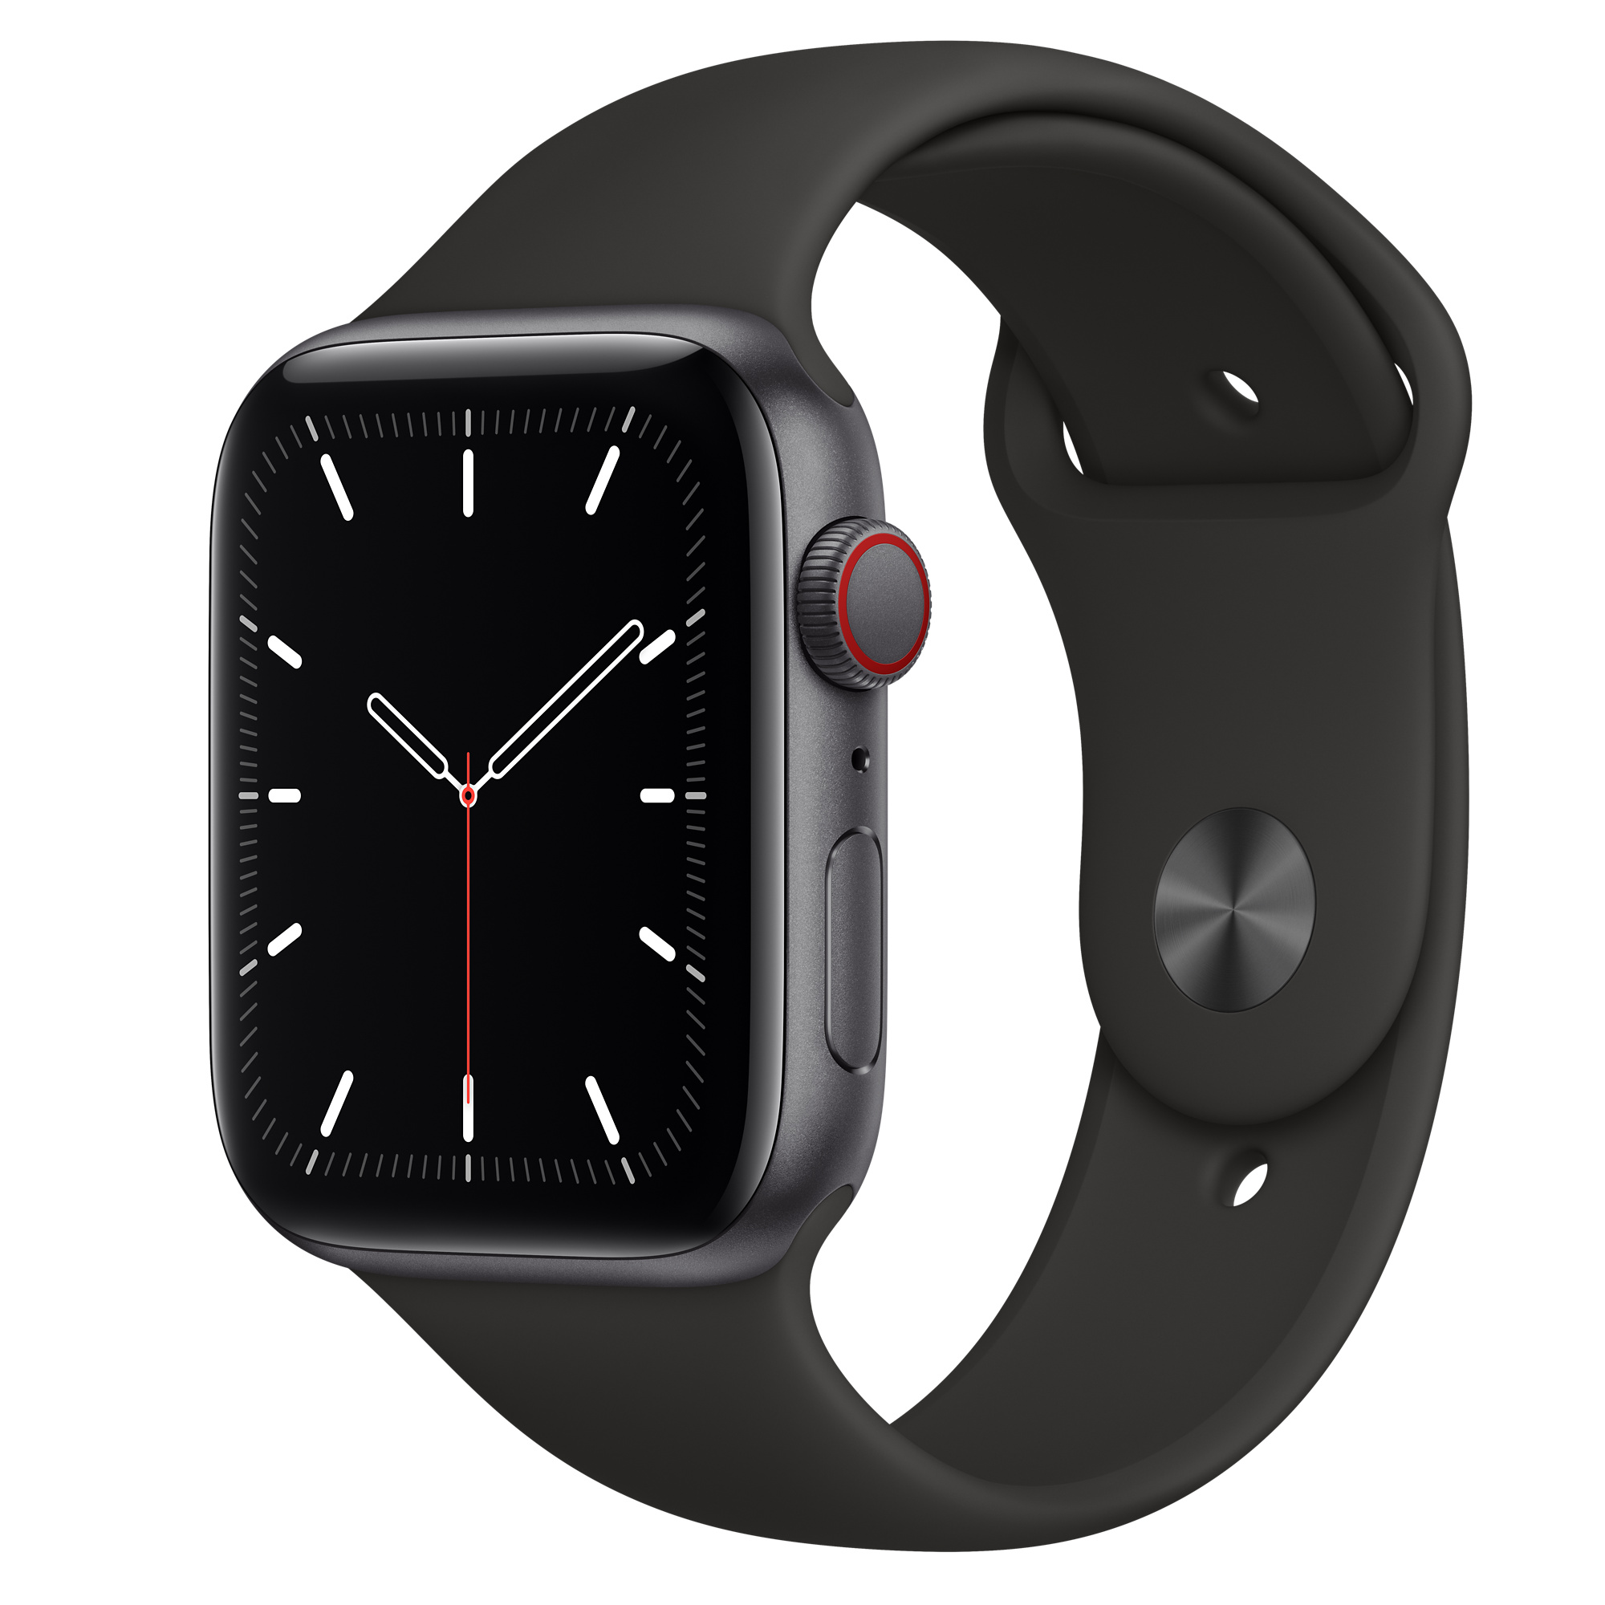
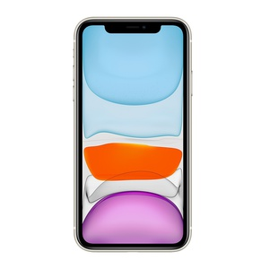
System Overview
Sensor Data
Smartphone
GPS, accelerometer, barometer, compass, gyroscope, proximity sensor
Smartwatch
Physical: heart rate, ECG, thermometer, pulse oximeter
External: accelerometer, barometer, compass, gyroscope, ambient light, GPS
Provide feedback: through earphones or vibration
Gather physical data using smart watch sensors
Use locational query data and smartwatch data to calculate optimal pace with ML
Optional: use data/ML to detect good running posture

Slide 7
Specifications
Sensor Data
Smartphone
GPS, accelerometer, barometer, compass, gyroscope, proximity sensor
Smartwatch
Physical: heart rate, ECG, thermometer, pulse oximeter
External: accelerometer, barometer, compass, gyroscope, ambient light, GPS

Slide 8
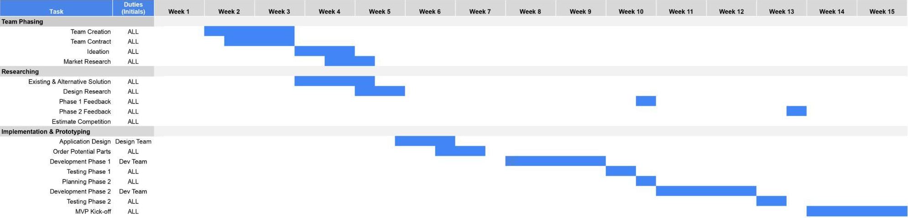
Planning

